Slide 1
Developing a Machine Learning Model

Slide 2
Machine Learning
Supervised Learning
Unsupervised Learning
Clustering
Dimensionality Reduction
Regression
Classification
Machine Learning
Notes:
Supervised Learning – predicting values to a known target.
Unsupervised learning – searching for structures in the data to unknown targets.
In our data, we have known malignant and benign patients – see if our algorithm can assign to our defined groups.

Slide 3
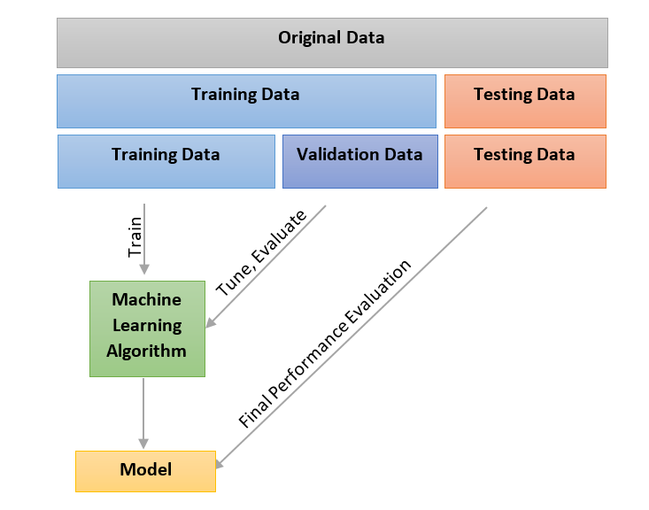
Building a Model

Slide 4
Machine Learning
Feature Selection
Training Control
Statistics
Algorithms:
Linear Classification – GLM + LDA
K-Nearest Neighbours - KNN
Tree-based Models – RPART + RF
Neural Networks - NNET
Gradient Boosted Machines
Support Vector Machines
Notes:
Yellow to be applied

Slide 5
1. Feature / Variable Selection
Subsets of features that are relevant to our model by removing features that are redundant.
With more features, we have increased complexity.
With increased complexity, we have a model that is more unexplainable and uncertain (relevance between each feature and class label).
Data
Filter
Embedded
Wrapper
Notes:
This distinction between feature selection methods and the algorithm applied is blurred.
For purposes of what we’re going to do, talk broadly about wrapper, filter and embedded.
Use a filtration method.
Wrapper – uses algorithm to build classifier - some models use elements of feature selection in their algorithm. Does this reiteratively to determine an optimal number of features. Can get uncontrolled growth + tendency to overfit [overemphasising non-reproducible patterns].
Filter – predictive subsets by using statistics from the distribution of data. Pearson correlations, variances.
Embedded – selecting and tuning the subset of feature prior to building

Slide 6
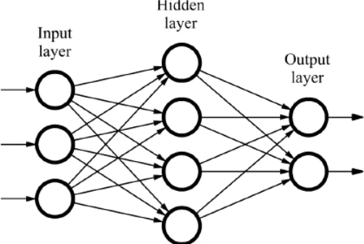
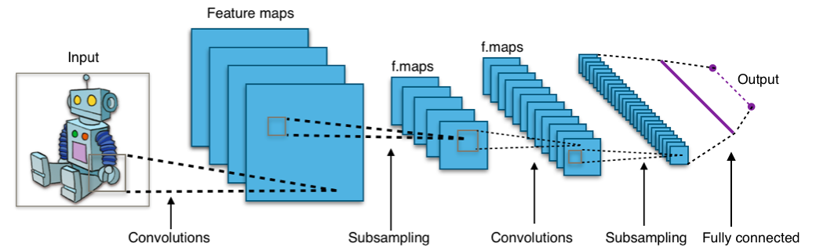
Neural Networks
Notes:
Supervised learning approach to looking to identify patterns.
Neural networks map a arrange of inputs to a range of possible outputs. These connections form “neurones” – functions that are usually played into layers.
Each layer of neural functions are evaluated to produce an output and if its correct the weights of neurons are increased or decreased based on the probability of reaching the correct answer.

Slide 7
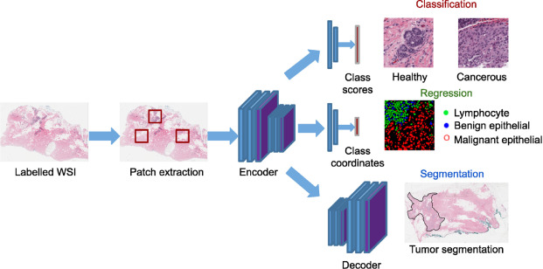
Applications of Neural Networks

Slide 8
Further Reading
Skin Cancers (https://www.nature.com/articles/nature21056)
Retinal Diseases (https://www.nature.com/articles/s41591-018-0107-6)
Thoracic Diseases (https://journals.plos.org/plosmedicine/article?id=10.1371/journal.pmed.1002686)

Slide 9
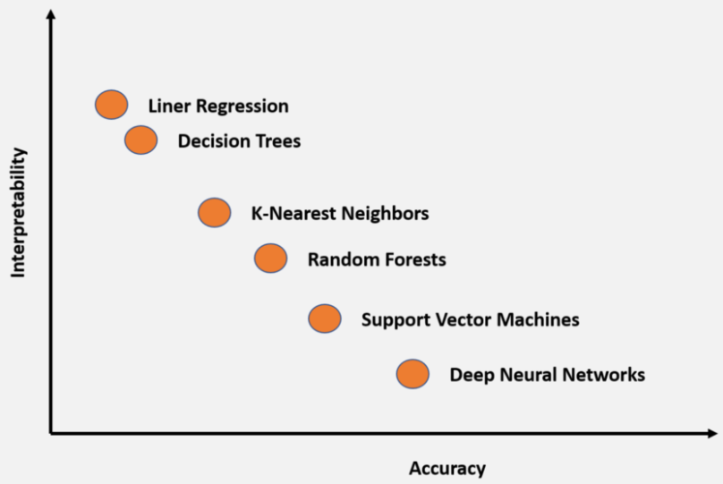
Explainable Models

Slide 10
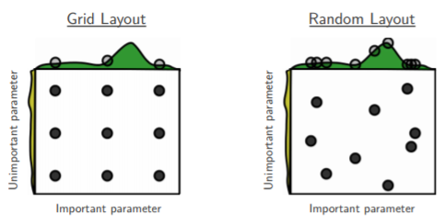
Tuning Methods
Grid Searching - Testing sets of hyperparameters by brute force. Exhaustive but slow.
Random Search – Samples from the search space selected at random.
Bayesian Optimisation – factors in uncertainty by using a measure of how ‘extensively you have sampled at iteration.’ So helps account for the factor you have sampled in different areas.
Notes:
Grid Searching -

Slide 11
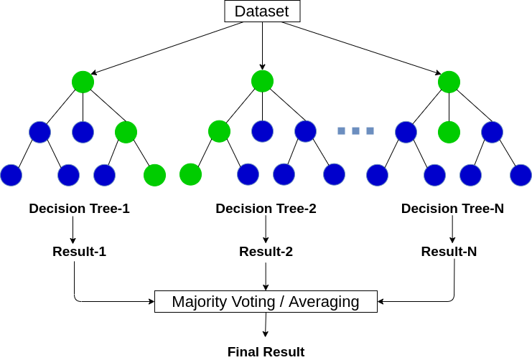
Decision Trees

Slide 12
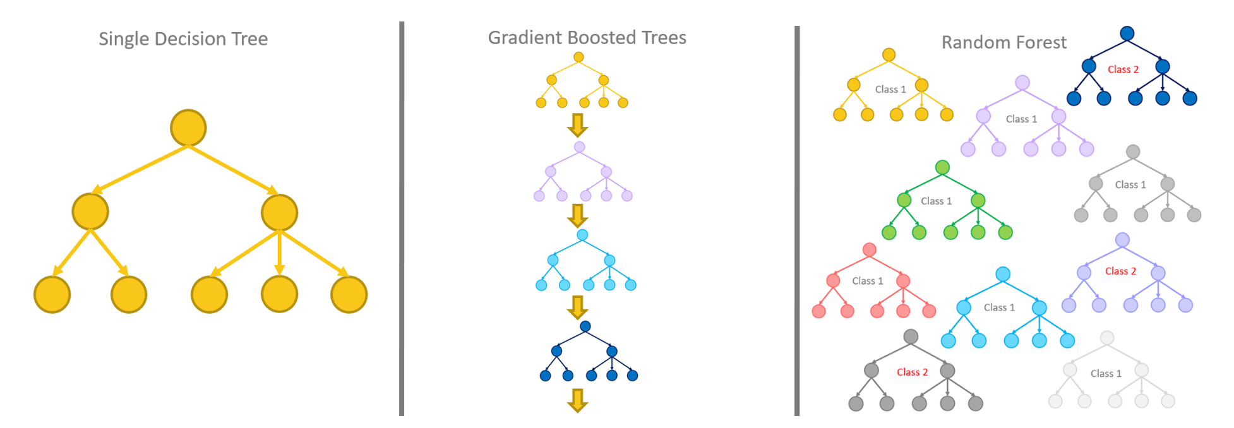
Decision Trees

Slide 13
RandomForests – Parameters to Change?
Number of Trees
Depth of each Tree – how many splits are below
Bootstrap Method – continuously resamples the data and makes a decision tree using a subset of samples.

Slide 14
For Next Time
Adjust our code to tune using other parameters or other methods!
https://topepo.github.io/caret/train-models-by-tag.html
https://topepo.github.io/caret/model-training-and-tuning.html
Advanced Background on Tuning and Optimising
https://www.amazon.co.uk/Introduction-Statistical-Learning-Applications-Statistics/dp/1461471370

